Slide 1


Enterprise Data Architecture
In this presentation, I will share my experience working with enterprise data architecture, highlighting best practices and industry standards. We will dive into DAMA-DMBOK, TOGAF, and ARIS tools, demonstrating their practical application through a real-world example.

Slide 2
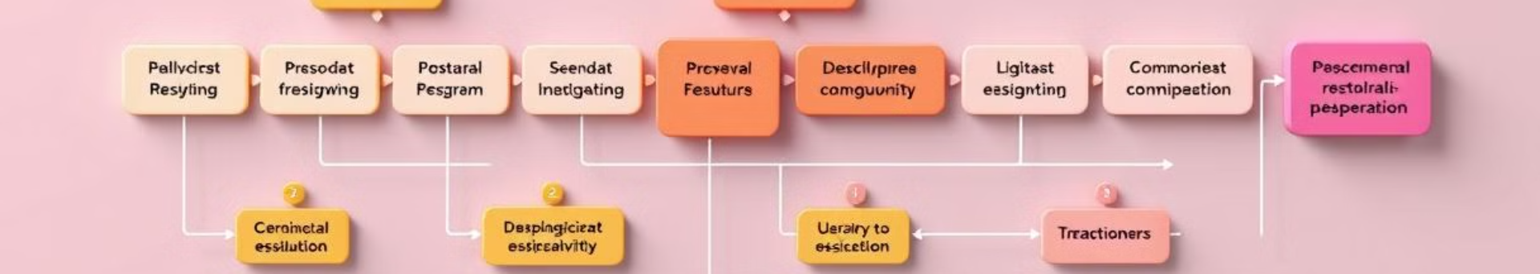
Overview of DAMA-DMBOK Framework
1
Data Management Body of Knowledge
2
Best Practices and Standards
The DAMA-DMBOK is a comprehensive guide to data management, encompassing the full data lifecycle.
It provides a standardized framework for addressing data-related challenges and ensuring data quality, integrity, and security.
3
Unified Approach
4
Industry Recognition
DAMA-DMBOK promotes a consistent approach to data management across organizations, fostering collaboration and efficiency.
This framework is widely recognized and adopted by data professionals globally, fostering knowledge sharing and best practice adoption.

Slide 3
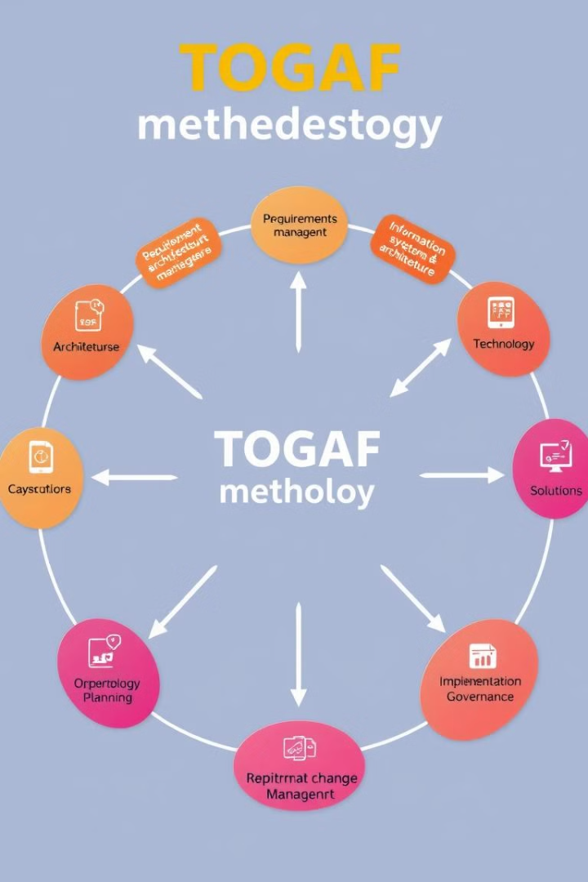
Applying TOGAF Methodology
1
Architecture Vision
We had a vision for the data architecture, outlining its purpose and key objectives.
2
Business Requirements
Defined the business requirements that the data architecture to address, ensuring alignment with organizational goals.
3
Architecture Definition
I developed the detailed data architecture blueprint, including components, relationships, and standards.
4
Implementation and Transition
Implemented the data architecture, ensuring a smooth transition and ongoing management.

Slide 4
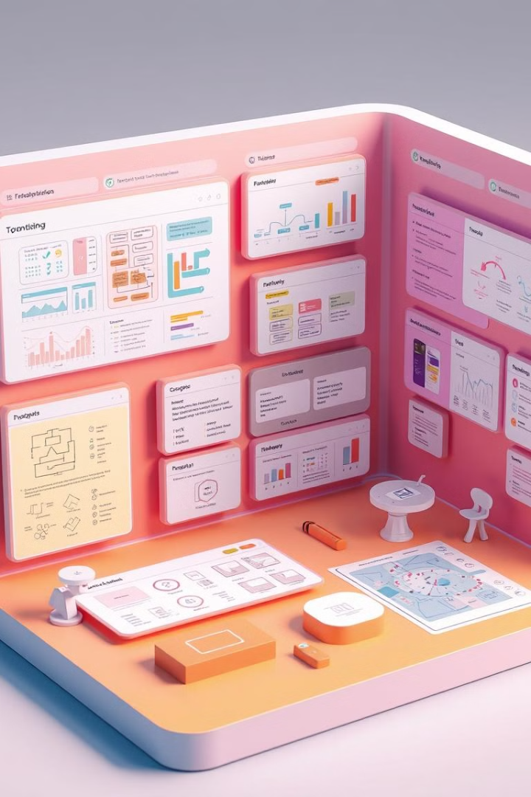
ARIS Tool for Enterprise Architecture
Modeling Capabilities
Data Integration and Analysis
ARIS helped us to support various modeling techniques, including data modeling, process mapping, and organization structure visualization.
It enabled us to integrate and make analysis of data from different sources, providing a comprehensive view of the enterprise data landscape.
Collaboration and Communication
Business Process Automation
ARIS supported business process automation, streamlining workflows and improving overall efficiency.
ARIS facilitated collaboration among stakeholders, promoting a shared understanding of data architecture and processes.

Slide 5
Data Architecture at NAC Kazatomprom JSC
Data Governance Framework
Data Modeling and Integration
Data Warehouse and Analytics
Implemented a data governance framework based on DAMA-DMBOK principles to ensure data quality and consistency.
Developed a comprehensive data model using ARIS to integrate data from various systems and provide a unified view.
Designed and implemented a data warehouse to support business intelligence and analytics, providing insights into key business metrics.

Slide 6




Data Governance and Stewardship
Data Policy and Standards
Established comprehensive data policies and standards to guide data management practices.
Data Ownership and Accountability
Defined data ownership roles and responsibilities, ensuring data accountability throughout the organization.
Data Access Control
Implemented access controls to protect sensitive data and ensure authorized access.

Slide 7
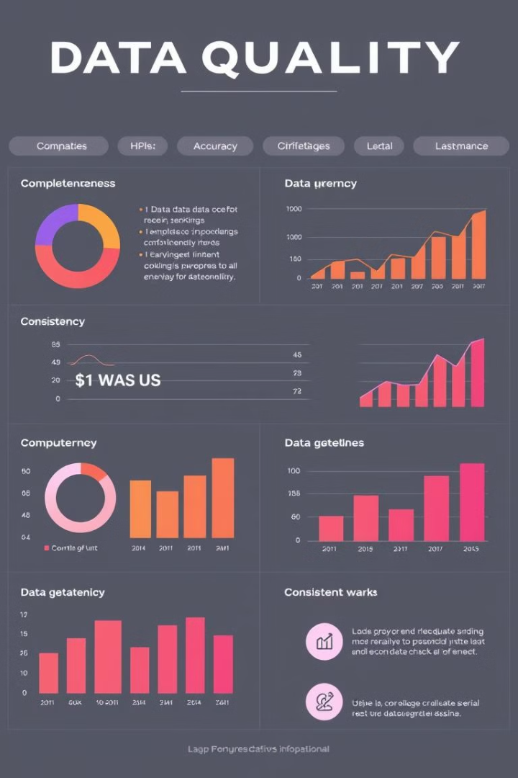




Data Quality Management
Data Accuracy
Data Completeness
Ensured data accuracy through data validation and cleansing processes.
Established mechanisms to ensure data completeness by addressing missing or incomplete data.
Data Consistency
Data Timeliness
Implemented data consistency checks to eliminate conflicting or redundant data.
Focused on data timeliness by ensuring data is updated regularly and made available in a timely manner.

Slide 8
Challenges and Lessons Learned
Data Silos and Inconsistency
Solution
We encountered various data silos across different systems and departments, leading to inconsistencies and difficulties in data integration. This challenge highlighted the importance of establishing a comprehensive data governance framework to ensure data quality and consistency.
Implemented a data governance framework based on DAMA-DMBOK principles to ensure data quality and consistency. This framework defined data ownership roles and responsibilities, established data standards, and provided guidance on data management practices.
Legacy Systems and Data Migration
Solution
The presence of legacy systems with outdated data models posed significant challenges in data migration and integration. We had to develop strategies for handling legacy systems, ensuring data accuracy and minimizing disruption to business operations.
Developed strategies for handling legacy systems, including data extraction, transformation, and loading (ETL) processes. We implemented data quality checks and validation procedures to ensure data accuracy during migration.
Stakeholder Engagement and Communication
Solution
Securing buy-in and effective communication among stakeholders from different departments was crucial for the success of the project. We learned the importance of clear communication, training programs, and ongoing engagement to ensure a shared understanding of the data architecture and its benefits.
Established a communication plan and conducted regular stakeholder meetings to keep them informed about the project's progress. We provided training programs to help stakeholders understand the data architecture and its implications for their work.
Data Security and Privacy
Solution
Ensuring data security and privacy was paramount, given the sensitive nature of the data being managed. We implemented robust data access controls and security measures to protect sensitive information and comply with relevant regulations.
Implemented robust data access controls and security measures, including encryption, access management systems, and data masking techniques. We also ensured compliance with relevant data privacy regulations.
Continuous Improvement
Solution
Data architecture is an ongoing process that requires continuous improvement and adaptation to changing business needs. We established mechanisms for monitoring data quality, performance, and user feedback to identify areas for enhancement and ensure the long-term effectiveness of the data architecture.
Implemented data quality monitoring and performance metrics to track the effectiveness of the data architecture. We also established feedback mechanisms to gather user input and identify areas for improvement.

Slide 9

Thank you !
Questions?

